Slide 1

Music Popularity Analysis
Exploration of the music industry
Crystal Xu, Diandian Yuan, Ruoxin Shi
Notes:
ydd

Slide 2
CONTENTS
Executive Summary and
Business Use Case
NoSQL Database
4
1
Data Analysis
Data Collection and Transformation
2
5
Data Model Design
Prediction
3
6
Notes:
ydd

Slide 3

01
Executive Summary and
Business Use Case
Notes:
ydd

Slide 4
Executive Summary
Background
In 2020, the total revenue of the recorded music industry amounted to 23.1 billion U.S. dollars. Streaming made up 56 percent of this figure, bringing in 11.9 billion dollars globally, and had a growth of 13.4% to $10.1 billion in 2020. This industry continues to flourish because of the great variety of streaming services. Popular songs could bring great revenue and the top 10 artists around the world created over 200 million revenue during last year. This phenomenon brings up the question of what characteristics contribute to a song’s popularity and success.
Introduction
Lyrics, time duration, artist, beat, loudness, rhythm are all key characteristics of a song. There are many previous studies about what characteristics make a song popular. Some of them analyze the songs’ lyrics but have limited results. We will rather focus on the following 3 questions:
Key Questions
What are the characteristics of hit songs?
Possibility of using old songs to predict the popularity of new songs?
What is the future music trend?
Notes:
ydd

Slide 5
Business Use Cases
Music Producing
A&R
Music Marketing
Music Recommendation
Provide music company a reference on the characteristics of the hit songs. So they can have a rubric or direction on song producing and finding new songs or artists.
Our project can help the company to decide the allocation of marketing resources. Based on the popularity predicted, the company can know which song they will get a higher return and decide the song need to put marketing emphasis on.
Music popularity prediction can also be used on music recommendations for a certain group of population. Music streaming platforms may use this project on their personalized recommendation system. Also, the platforms can adjust features and strategy plans based on the music trend analysis.
Notes:
ydd

Slide 6
02
Data Collection and Transformation
Notes:
ydd

Slide 7
Data Profile
Source | Description | Size | Link
Source 1 Spotify Songs | Structured data of Spotify song list in csv format. Including track id, name, artist, popularity, album, and attributes such as danceability, energy, loudness, speechiness, acousticness, instrumentalness, liveness, valence, temp, duration, etc. | 8.8MB 23 columns X 32.8k rows | https://github.com/rfordatascience/tidytuesday/blob/master/data/2020/2020-01-21/readme.md
Source 2 Spotify Database | Structured data of Spotify artist list and track list in csv format. Artist.csv: id, followers, genre, name, popularity Track.csv: id, name, popularity, duration_ms, explicit, artists, id_artists, release_date, danceability | Artist: 81.97MB 5 columns X 1.1M rows Track: 11.37MB 20 columns X 587K | https://www.kaggle.com/lehaknarnauli/spotify-datasets?select=artists.csv
Source 3 Spotify Artists & Albums | A synthetically generated music dataset for a small imaginary Music Labels. ARTISTS: Id, real_name, art_name, role, year_of_birth, etc. ALBUMS: Id, artist_id, album_title, genre, year_of_pub, num_of_tracks, num_of_sales, mtv_critic, etc | Artist: 5.3MB 9 columns X 50K rows Albums: 6.8MB 10 columns X 100K rows | https://datasetsearch.research.google.com/search?query=music&docid=L2cvMTFsajM4cjA0eA%3D%3D
Source 4 Billboard “The hot 100” Songs | Structured data for weekly Billboard Hot 100 CHARTS: Rank of song,Song title,Track Artist, Rank in previous week,etc | 18.2MB 7 columns X 330K rows | https://www.kaggle.com/dhruvildave/billboard-the-hot-100-songs
Notes:
ydd

Slide 8




Data Tools
MySQL
MongoDB
Python
Neo4J
Data Storage
Data Storage
Data Cleaning
& Analysis
& Data Visualization
Data Storage
Notes:
ydd

Slide 9

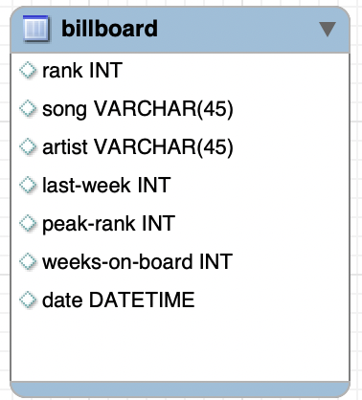
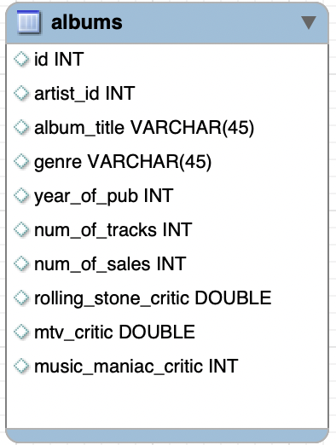
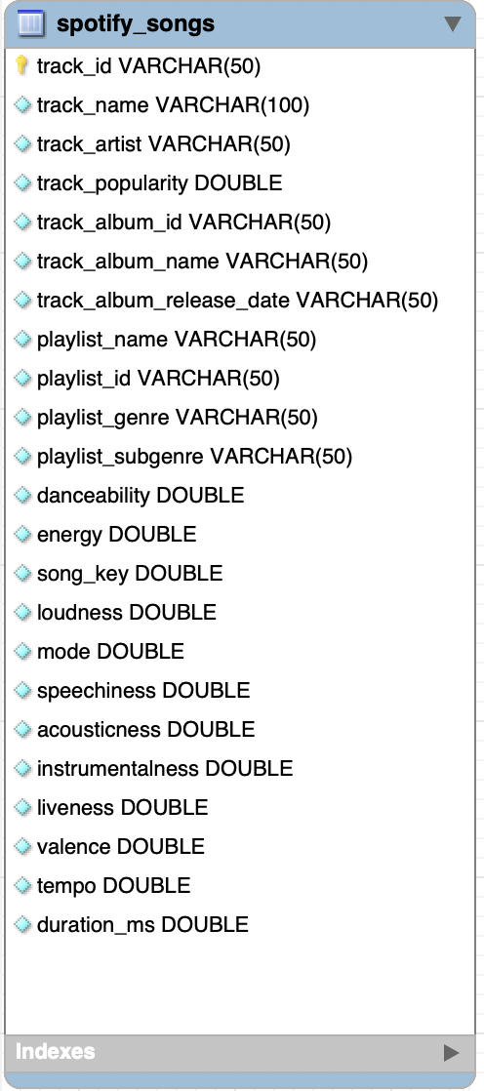
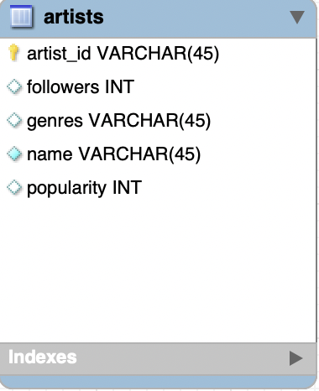
Data Processing
1
Load Data
Download csv from online datasets
Load csv into MySQL & GCP
2
Transfer/link Data
Separate spotify_songs table into track, playlist and album tables
Since tables are extracted from different data set, use song name, album name, artist name to match information through different tables
Notes:
Crystal

Slide 10
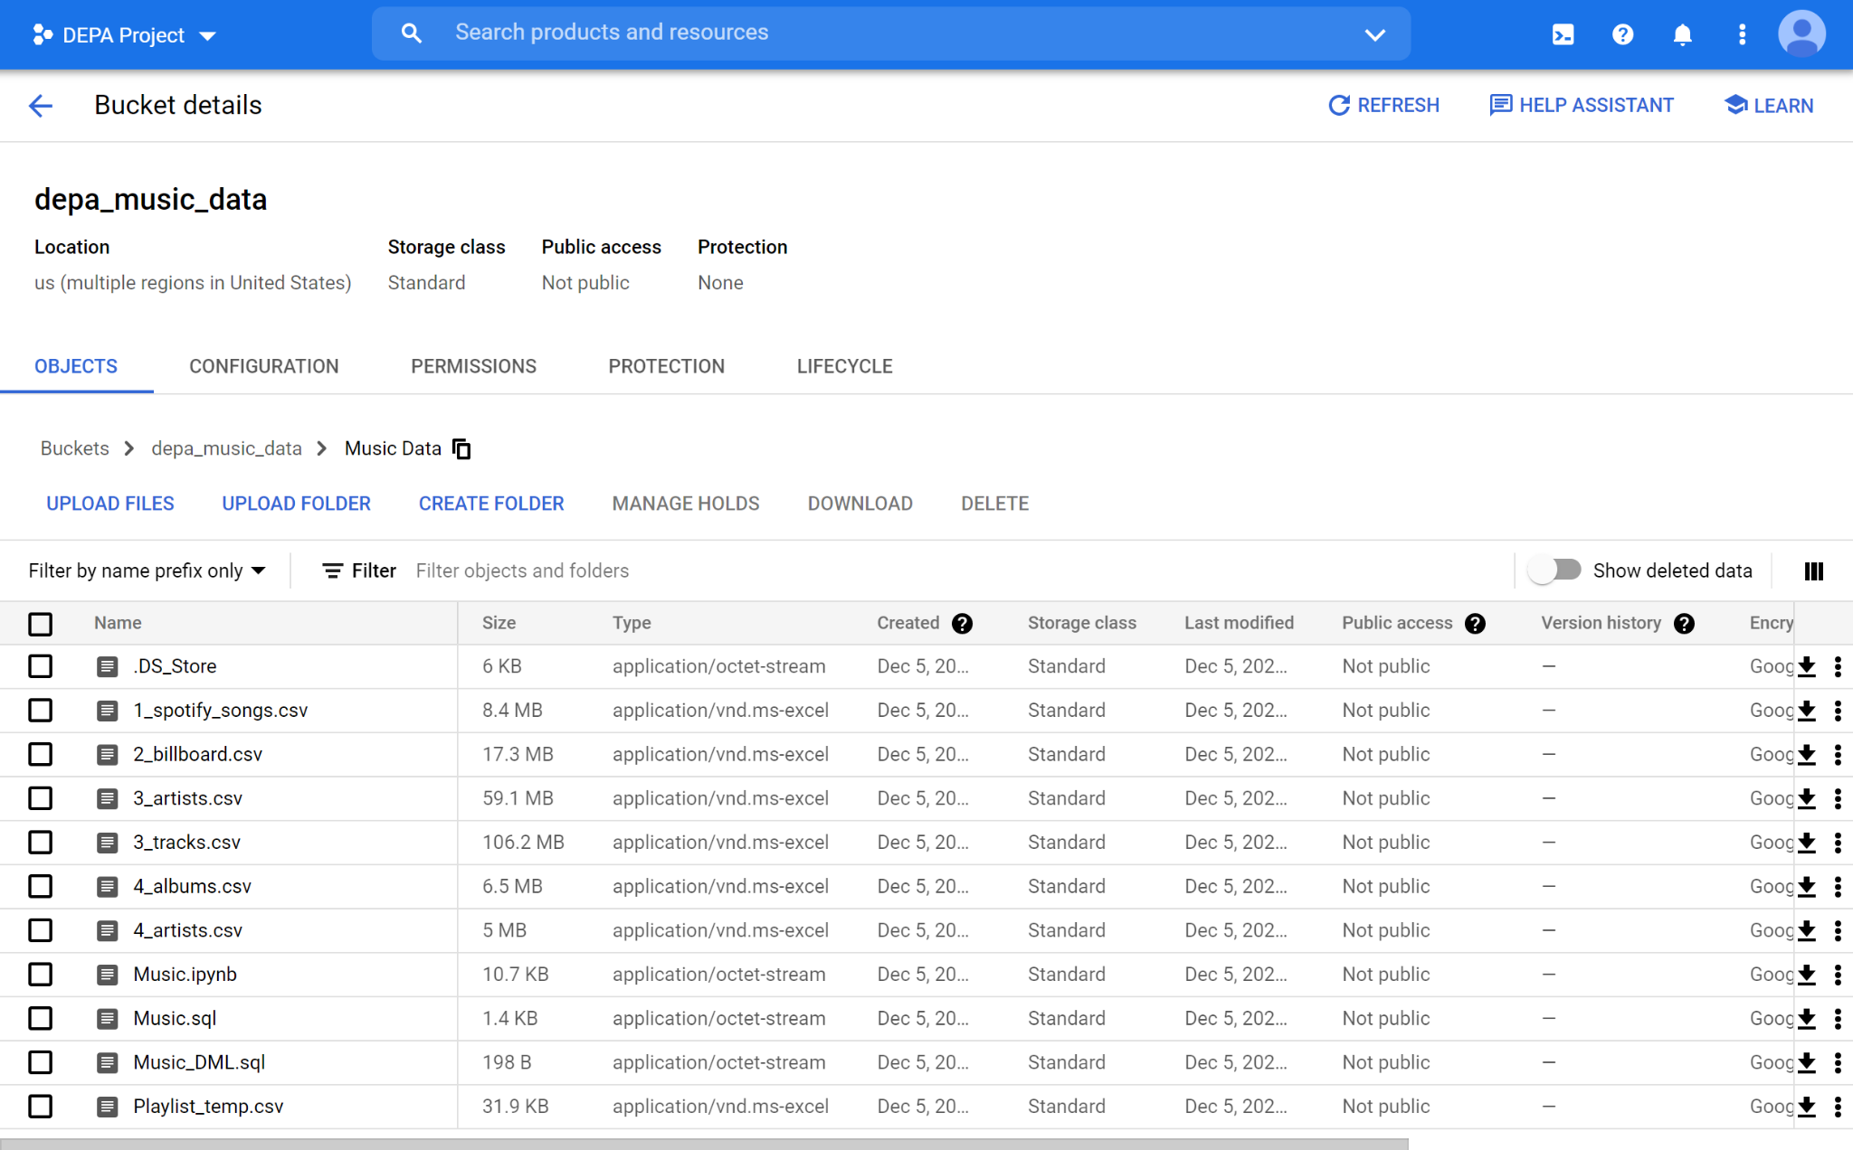
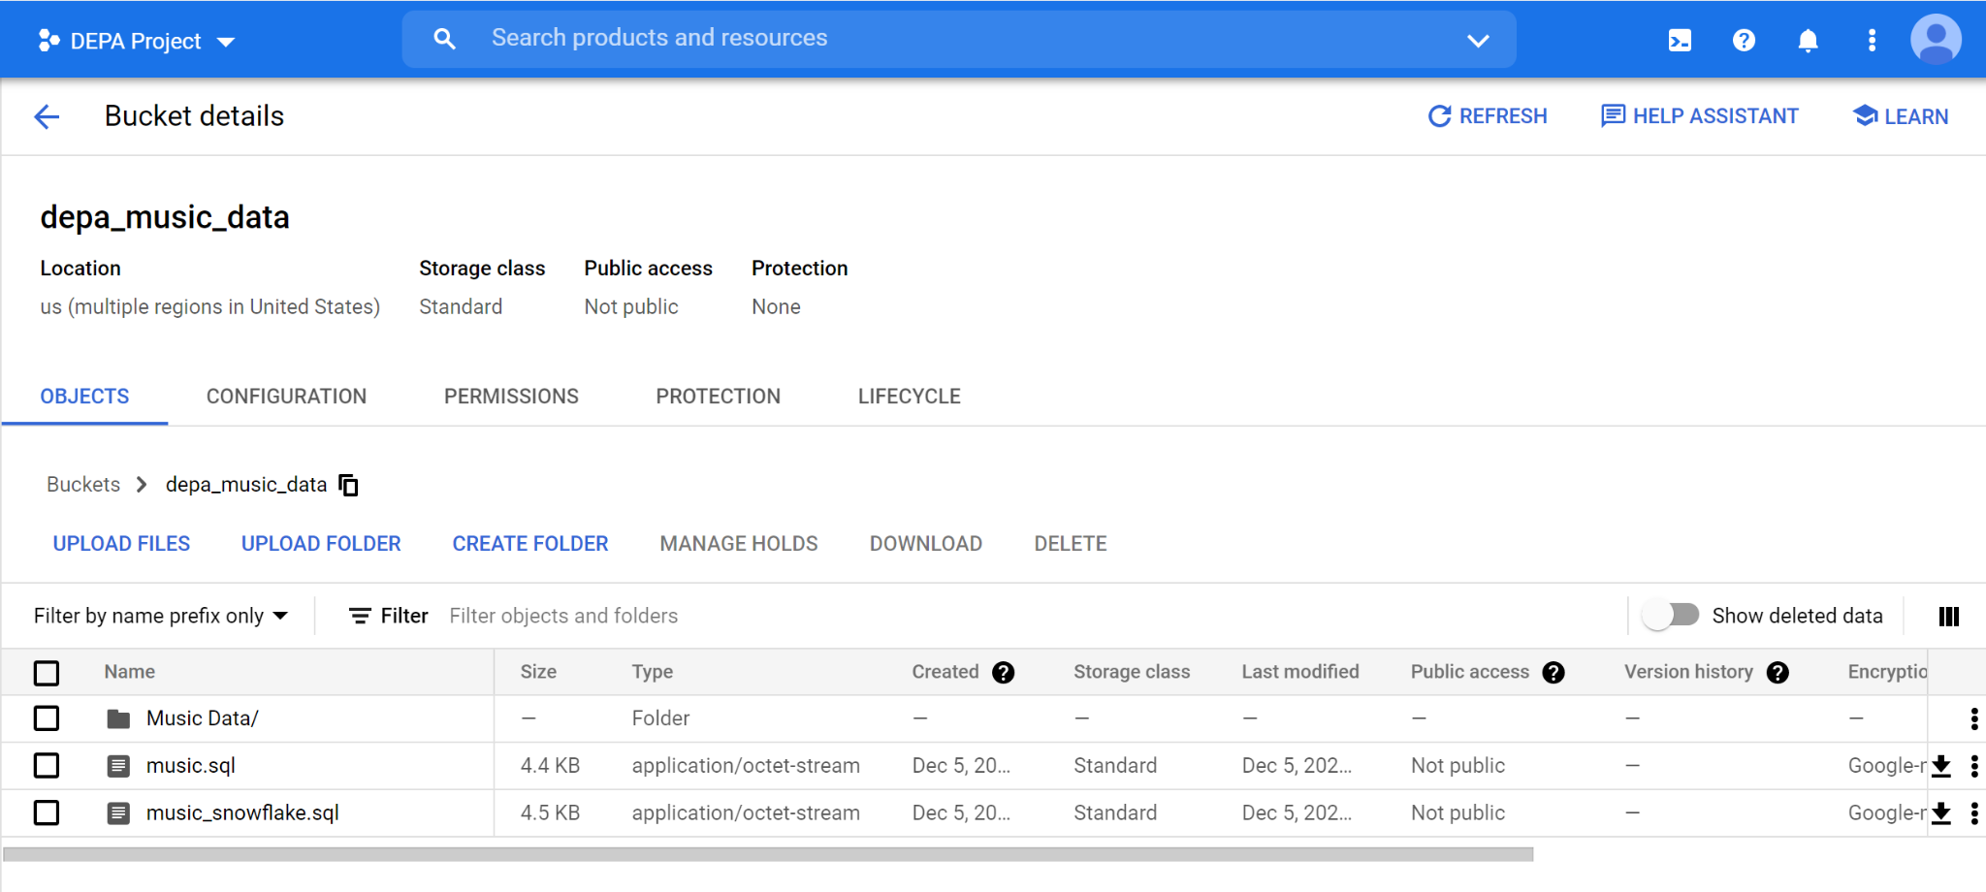
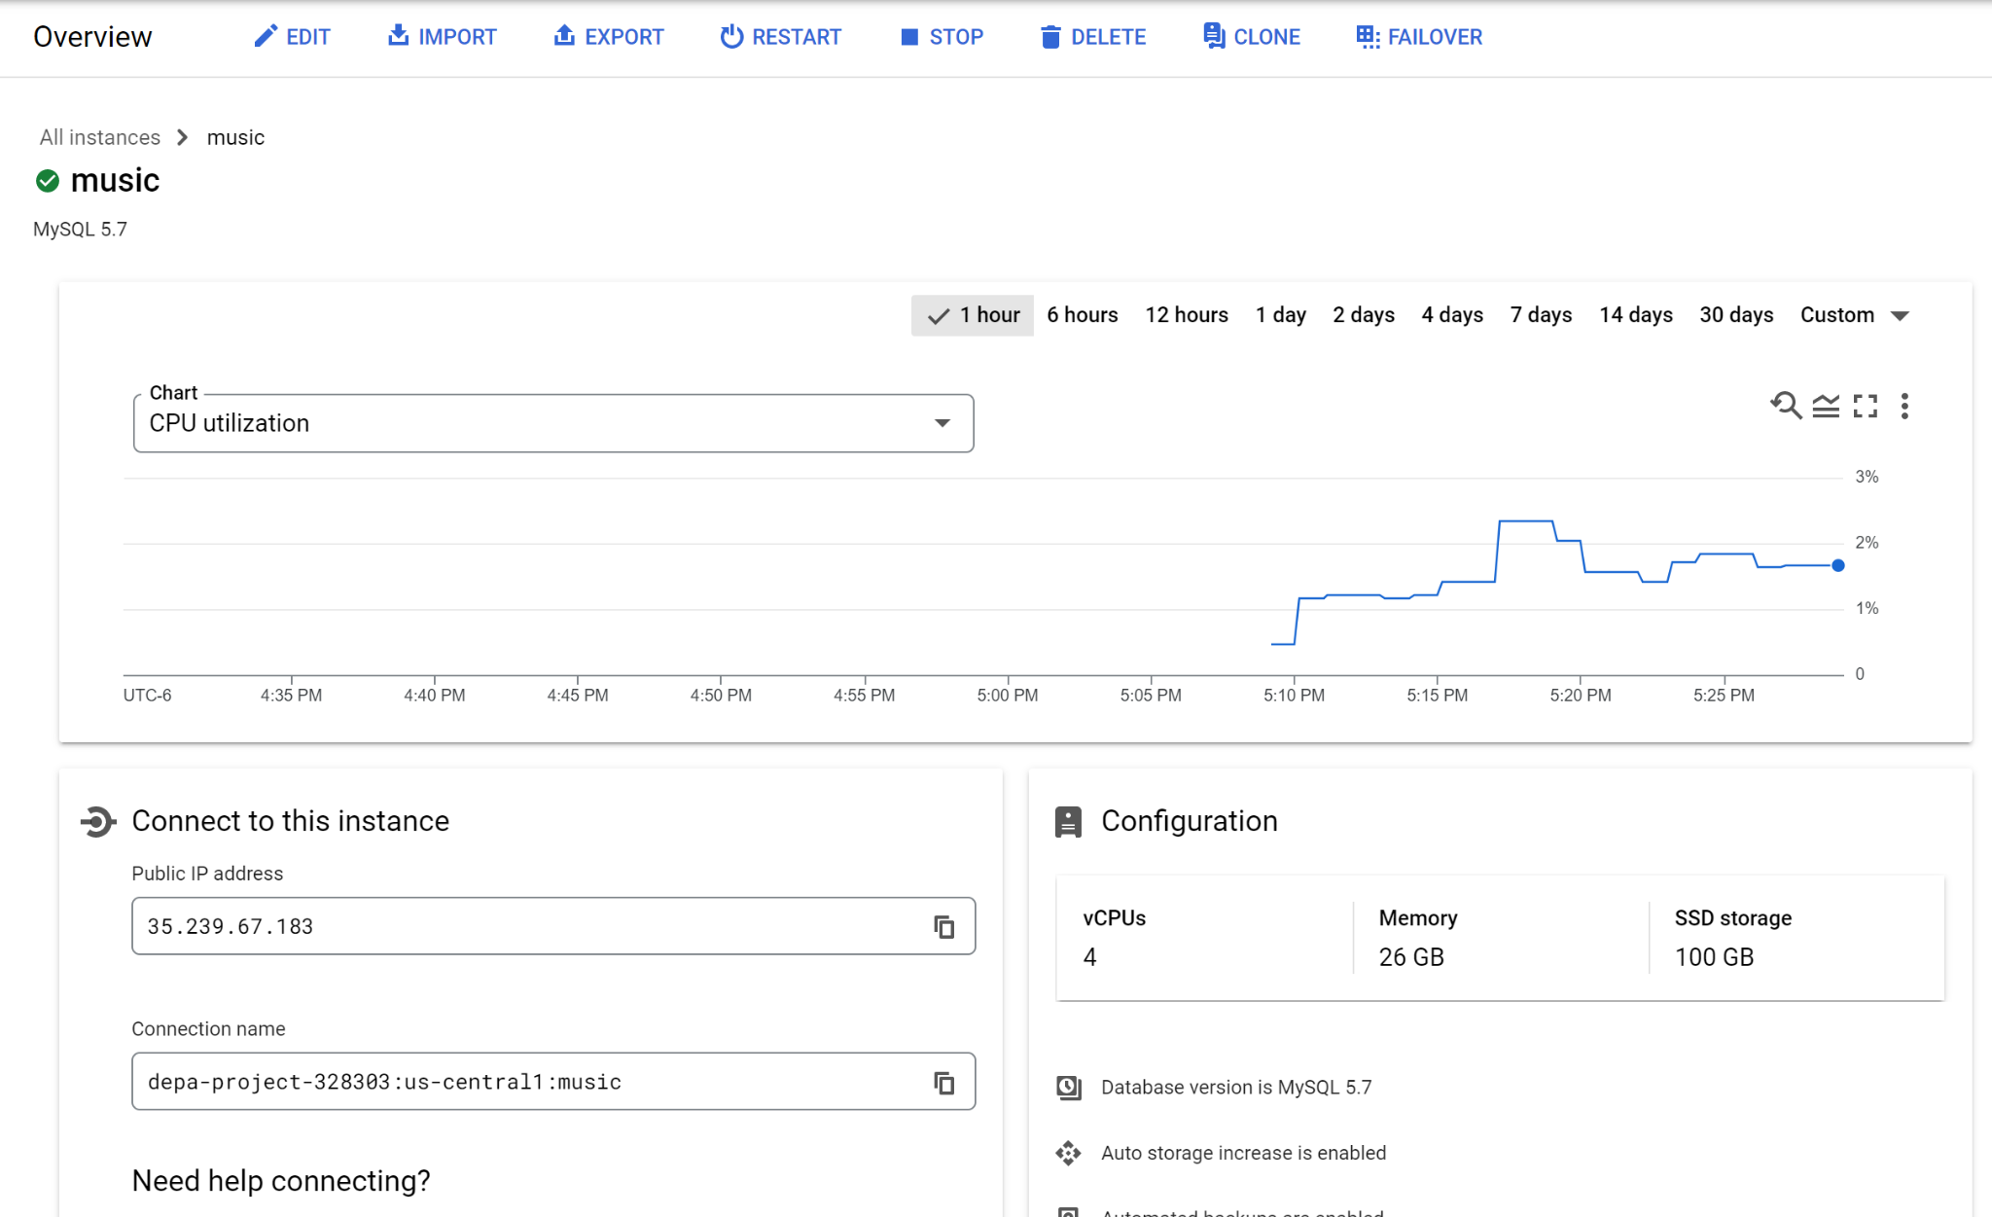
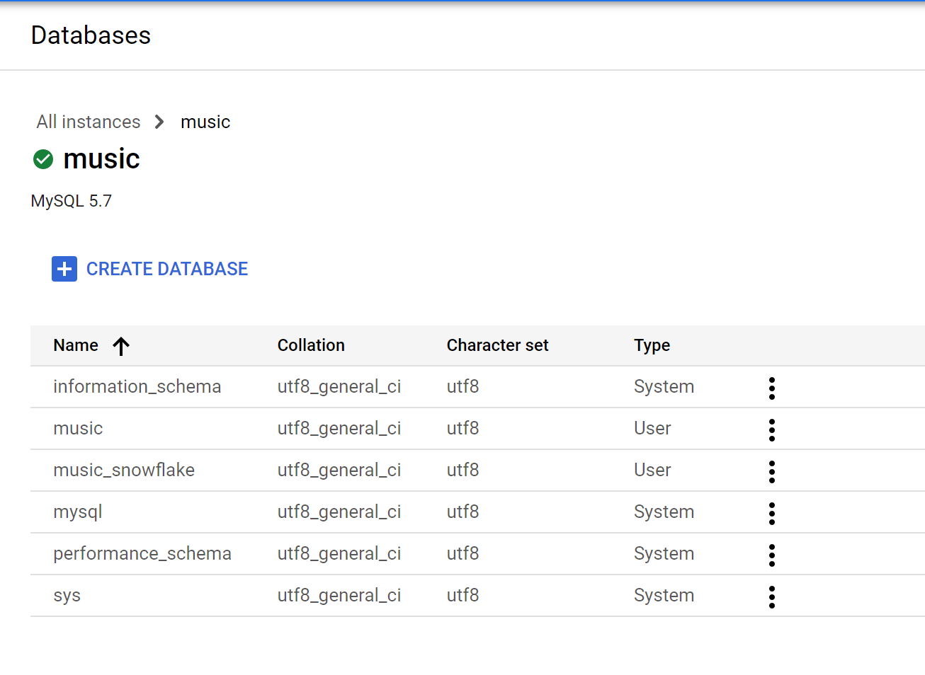
GCP - MySQL Instance
Notes:
Crystal

Slide 11
03
Data Model Design

Slide 12
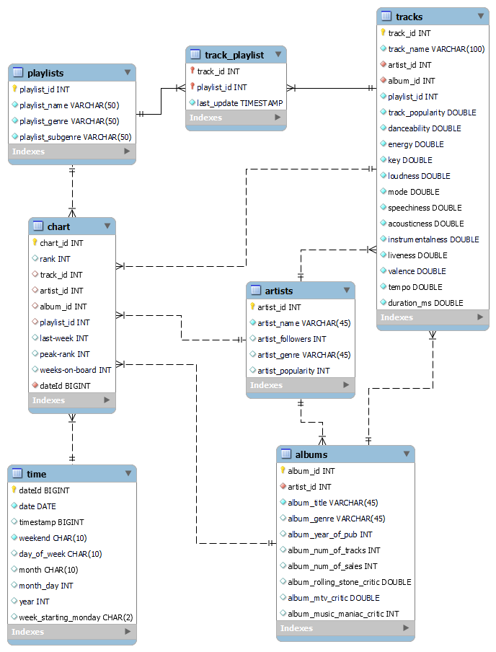
EER Model
Tracks:
Store the information about the songs (name, artist, album, playlist, popularity, features, etc)
Artists:
Store the information about the artists (name, followers, genre, popularity)
Playlists
Store the information about the artists (name, followers, genre, popularity)
Track_playlist:
A link table that connects tracks table and playlists table.
Albums:
Store the information about the albums(artist, title, genre, etc)
Chart:
Store the information about songs’ rankings
Time:
Contains the information for time reference in the chart table.

Slide 13
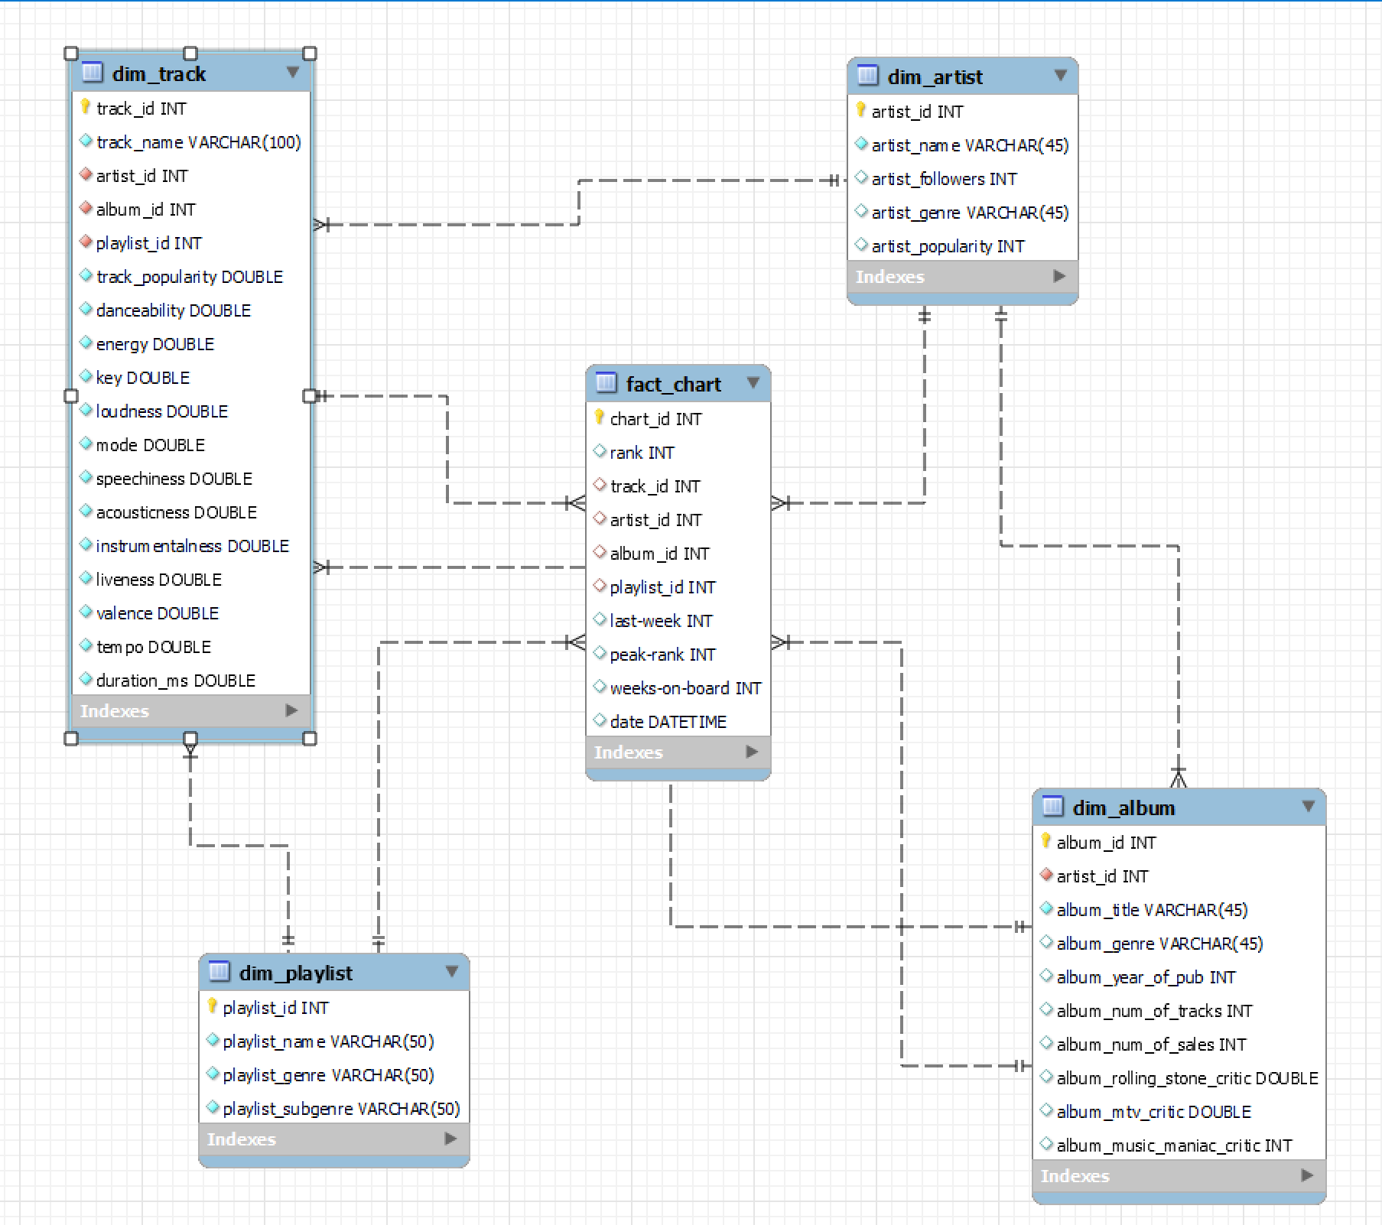
Dimensional Modeling
dim_artist:
Include the artist_id as primary key
Include the number of followers and the popularity index
Include the genre tag of the artist
dim_album:
include the album_id as primary key
Connected to dim_artist on foreign key artist_id
Include the albums’ genre, release year, number of tracks, number of sales
Include different critics scores: rolling stone, mtv, music maniac
dim_playlist:
Include the playlist name, genre, subgenre

Slide 14
Dimensional Modeling
dim_track:
Include the track_id as primary key and is connected to dim_artist, dim_album and dim_playlist on foreign key artist_id, album_id and playlist_id.
Include the popularity of the track.
Include the features of songs (built-in variables in Spotify data)
fact_chart:
the billboard ranking of a song (track)
chart_id as primary key
connected to dim_track, dim_artist, dim_album and dim_playlist on foreign key track_id, artist_id, album_id and playlist_id
Include the ranking of this week, last week, the peak rank, the weeks-on-board and the date of the chart

Slide 15
04
NoSQL Database
Notes:
ydd

Slide 16
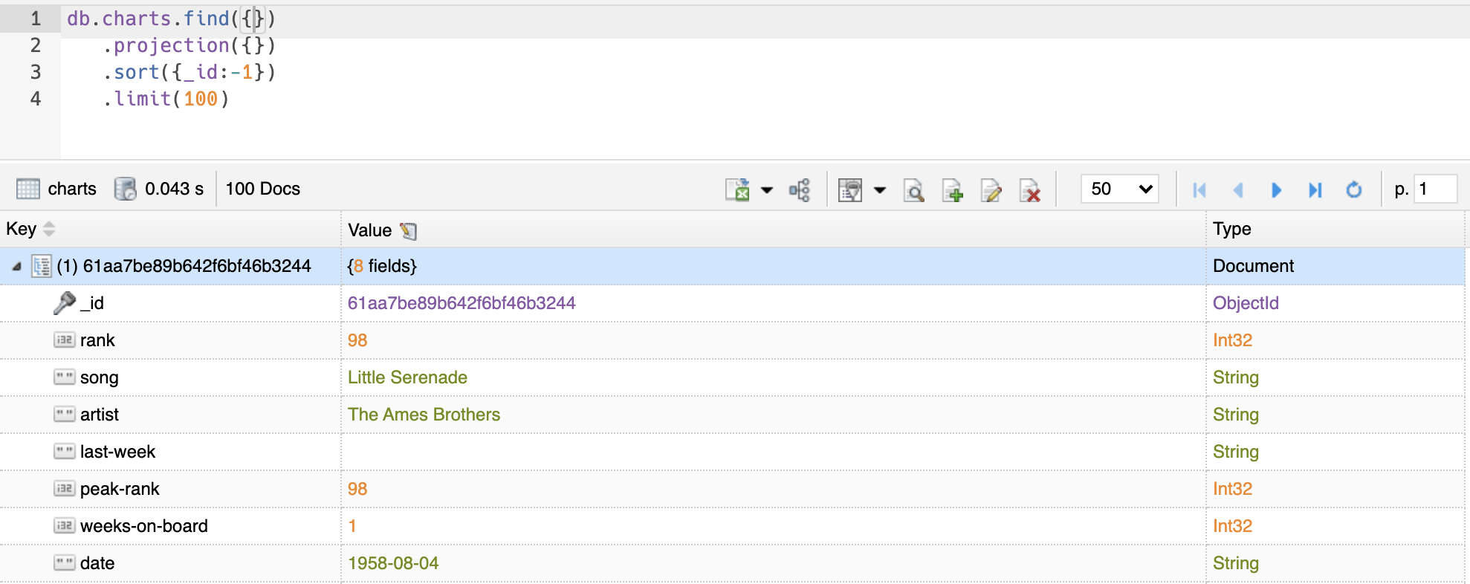
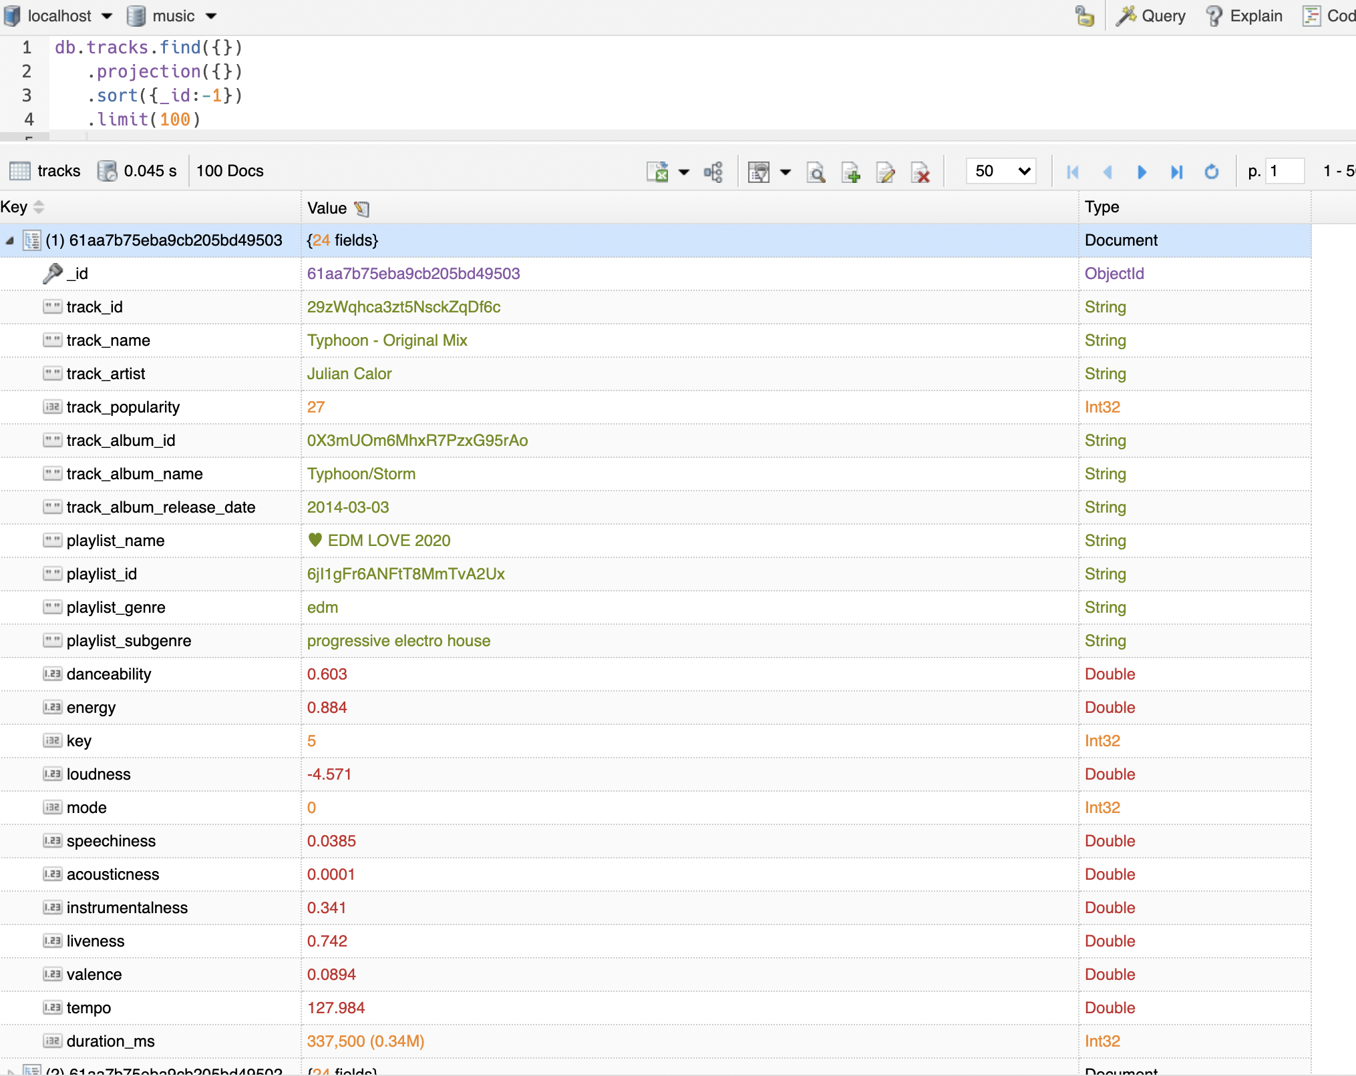
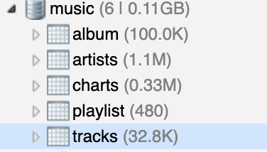
MongoDB
Construct 5 collections
The attributes of each tables are converted to corresponding cases
Advantages:
Data can directly import from csv
Adding feature or data point is easier
Minimal constraints of queries
Notes:
ydd

Slide 17
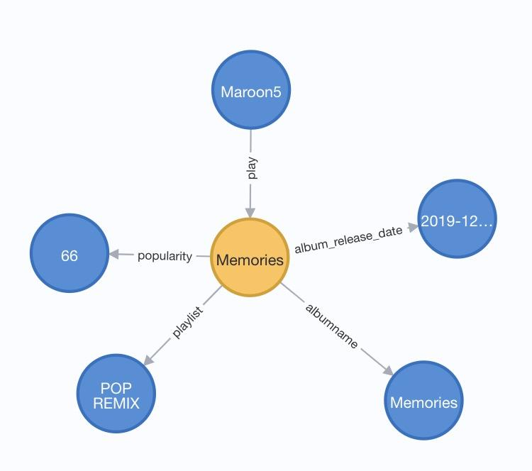
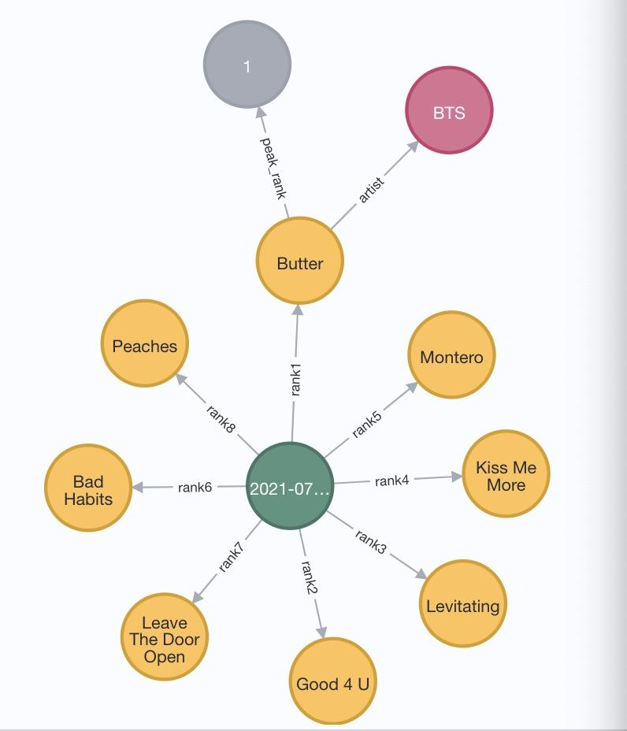
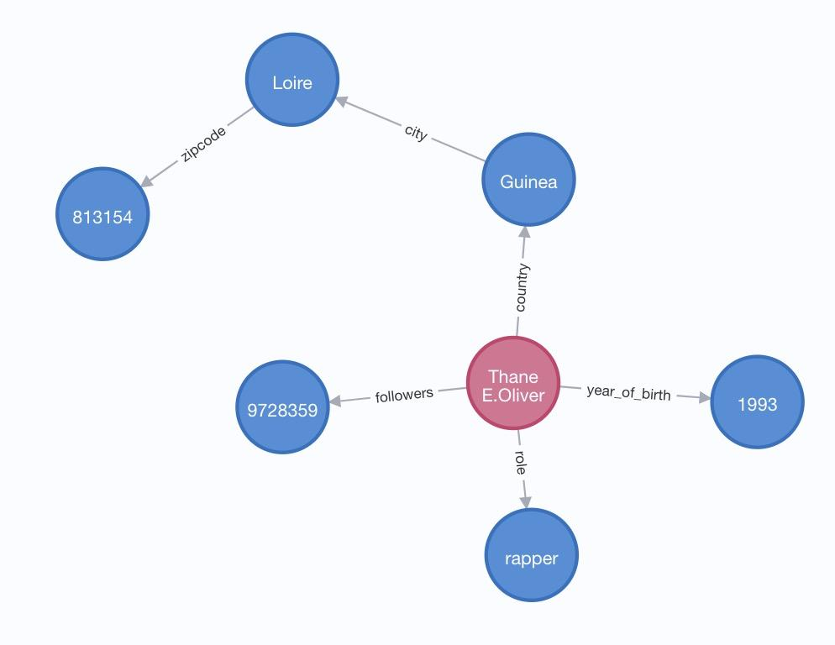
Neo4j
For billboard 2021-07-17
top 8 songs
(billboard)-[:rank1]->(songs)
For artist basic information
E.g.
(artists)-[:followers ]->(number_followers) (artists)-[:year_of_birth]->(birth)
For songs basic
Information
E.g.
(songs)-[:popularity]->(popular) (songs)-[:albumname]->(album_name)
Notes:
ydd

Slide 18
05
Data Analysis

Slide 19
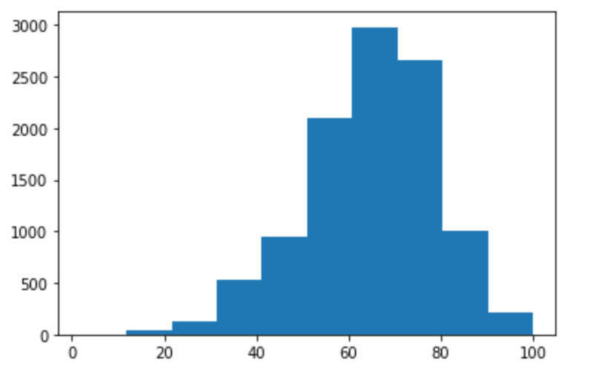
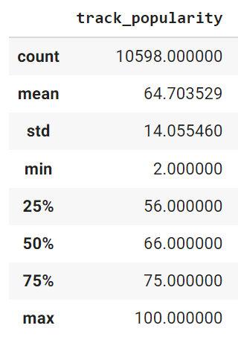
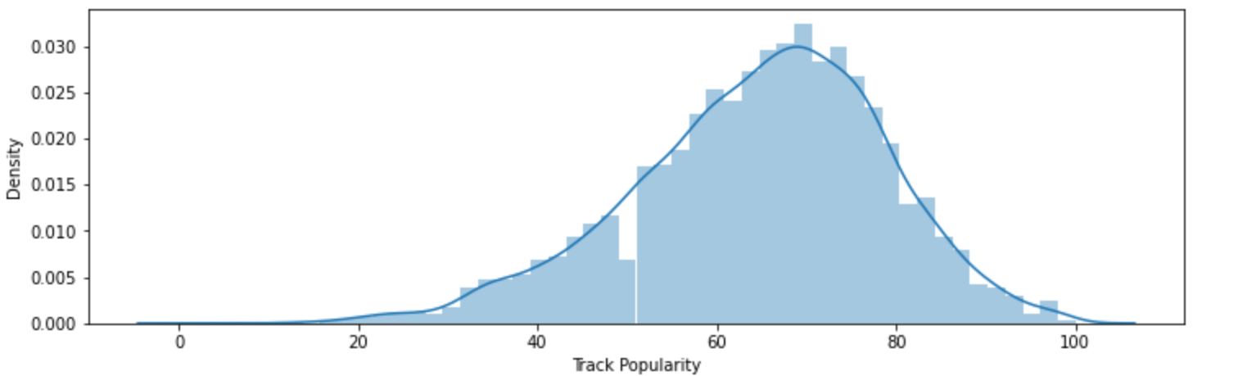
Track Popularity
Most of the songs’ popularity score are lying between 60 - 80. The mean value is around 65 with a standard deviation of 14.
The distribution of songs popularity scores

Slide 20
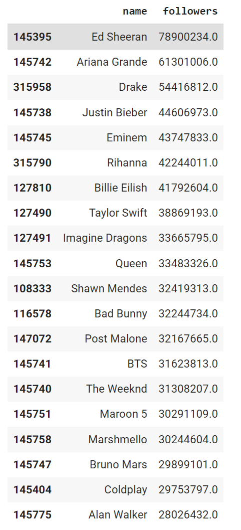
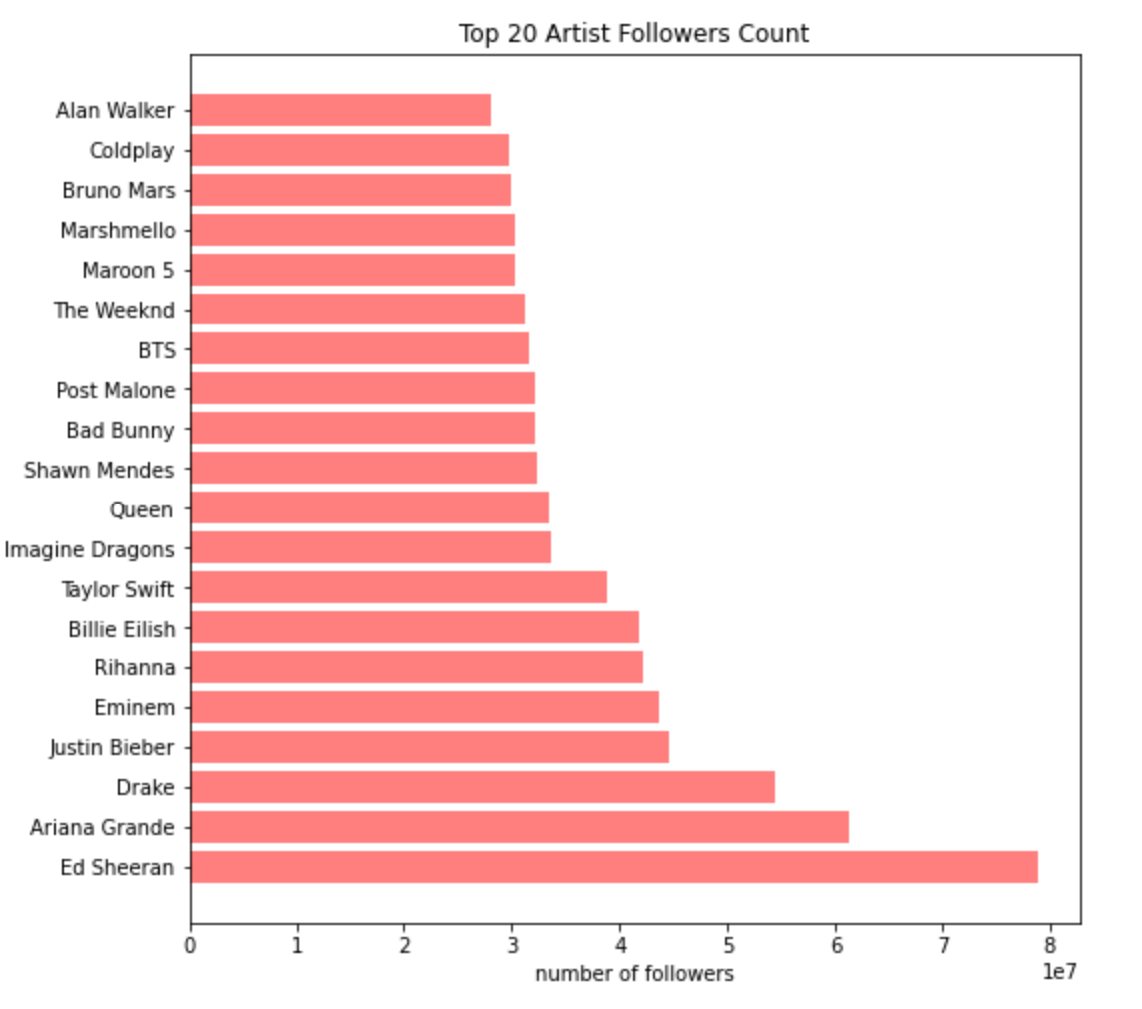
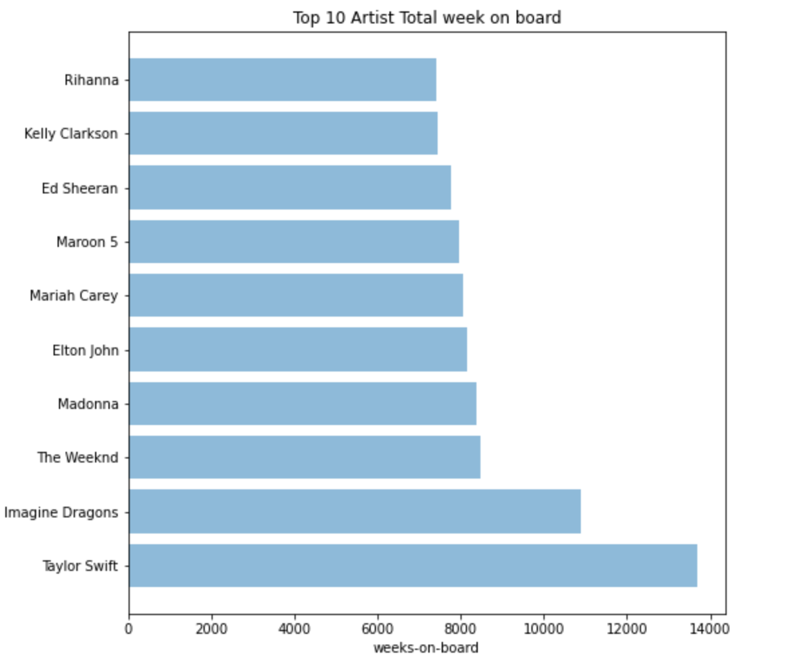
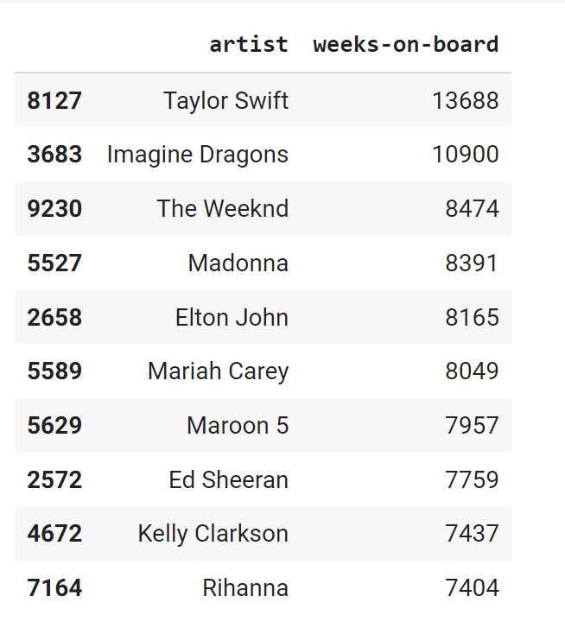
Artist Popularity
Top 20 Artist with most followers
Top 10 Artist with most total weeks on Billboard chart

Slide 21
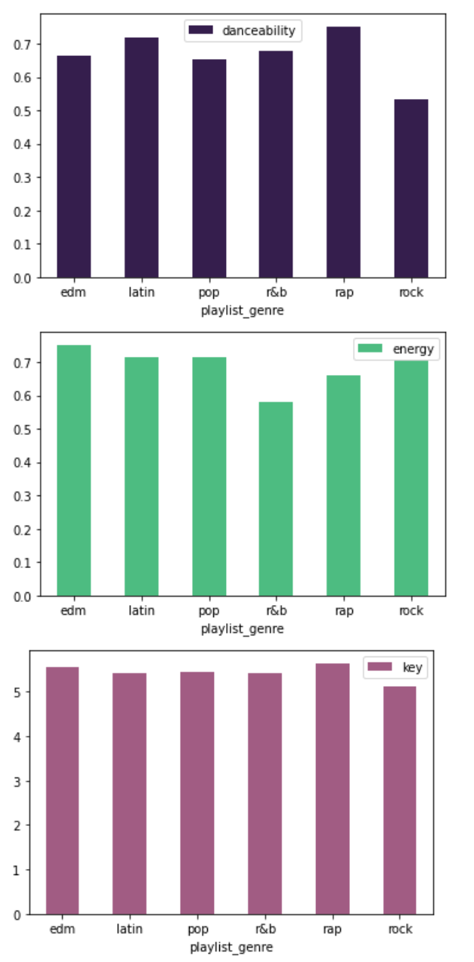
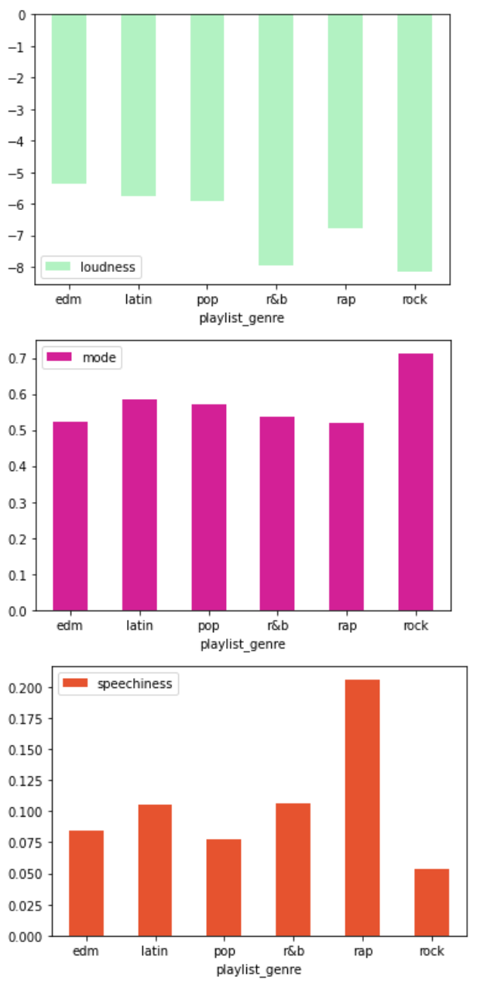
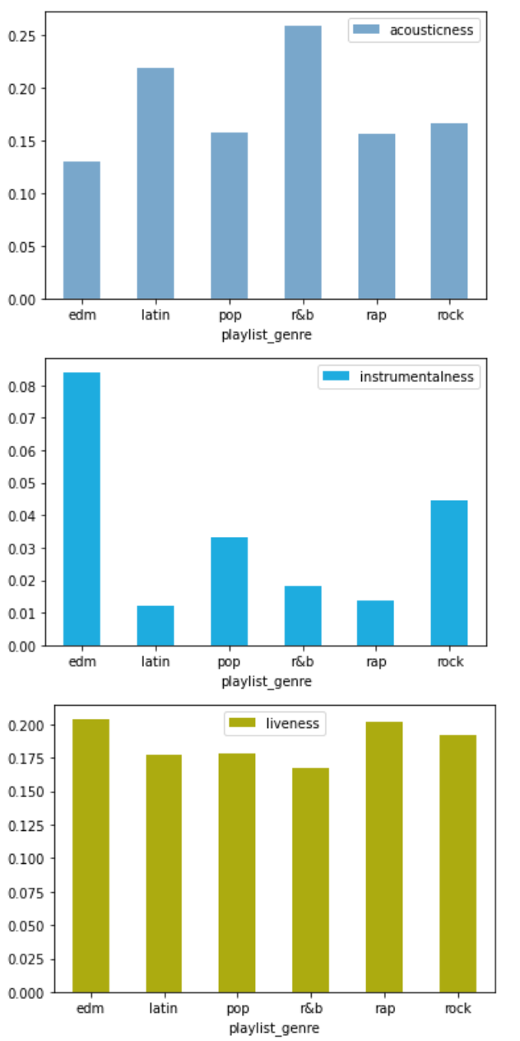
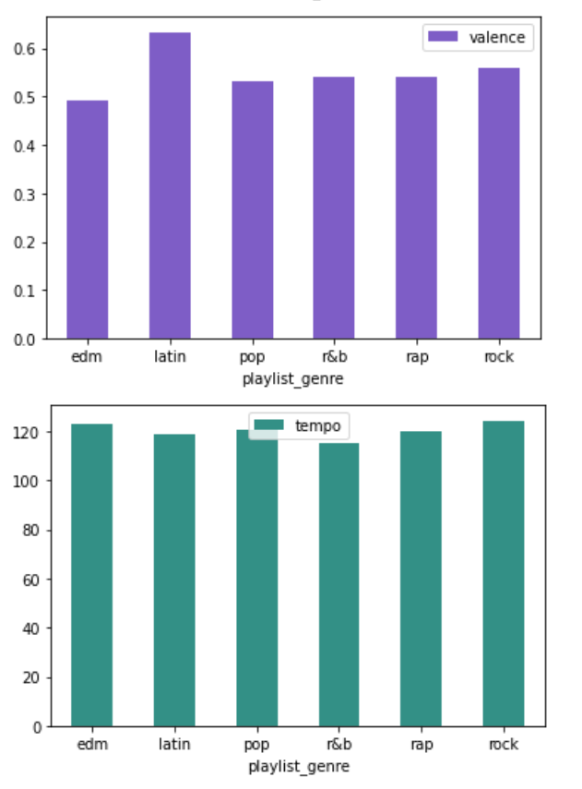
Spotify Track Attribute Analysis
Barplot for the average value of each attribute in each playlist genre.
*These are the Spotify’s special features for each song.

Slide 22
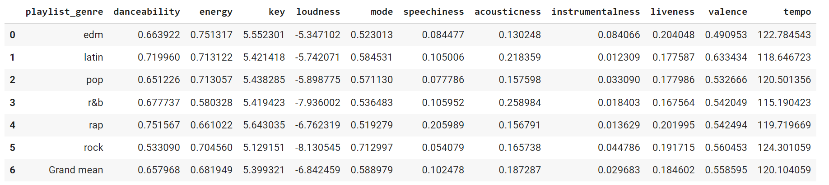
Spotify Track Attribute Analysis
Edm: high instrumentalness
R&B: high danceability, acousticness, loudness, lower instrumentalness
Rap: high speechiness, lower loudness
Rock: high mode, higher instrumentalness
Latin: higher valence, danceability, energy, lower instrumentalness
Pop: high energy, danceability,
Average tempo and key are not very different across all genre.

Slide 23
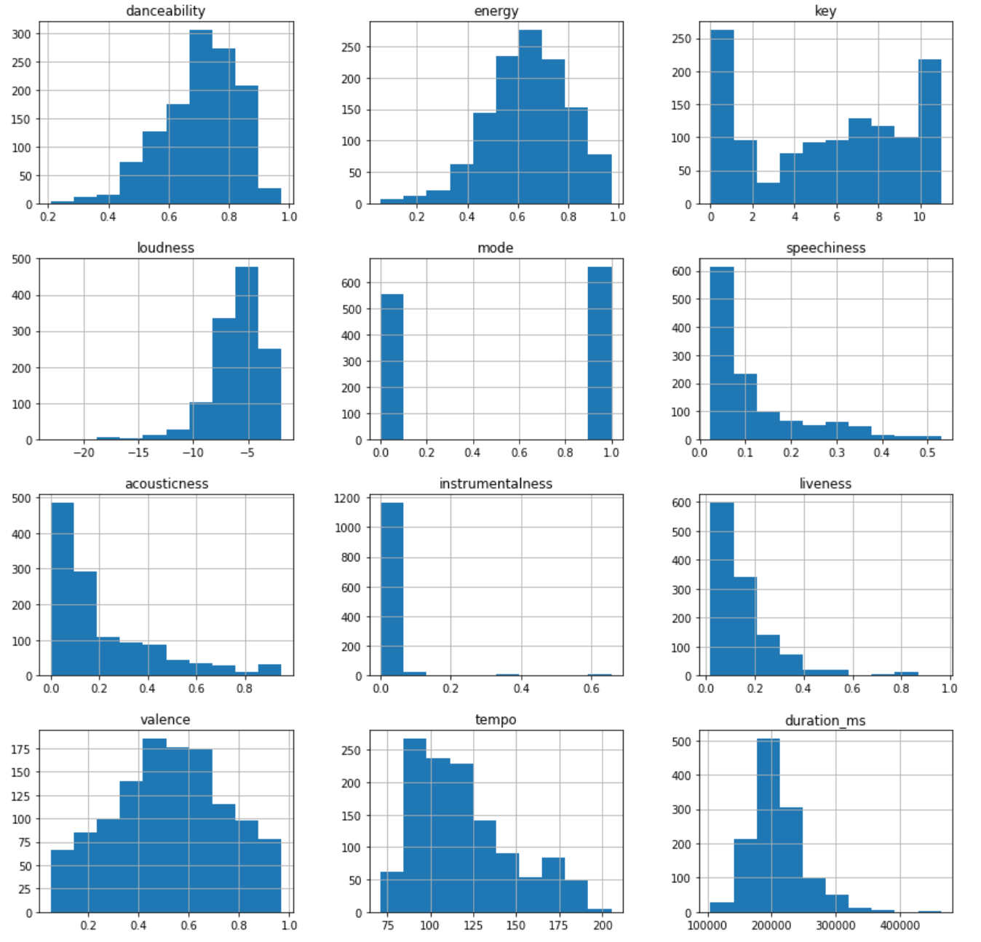
Spotify Track Attribute Analysis
Select the songs with popularity > 80 (we could say that these songs are relatively more popular) and plot the histograms of each attributes.
We could see that these songs have an overall higher danceability, energy and loudness, and lower speechiness, acousticness, instrumentalness, liveness and tempo. Valence are focused in the center region. And these songs do not have a very long durations.

Slide 24
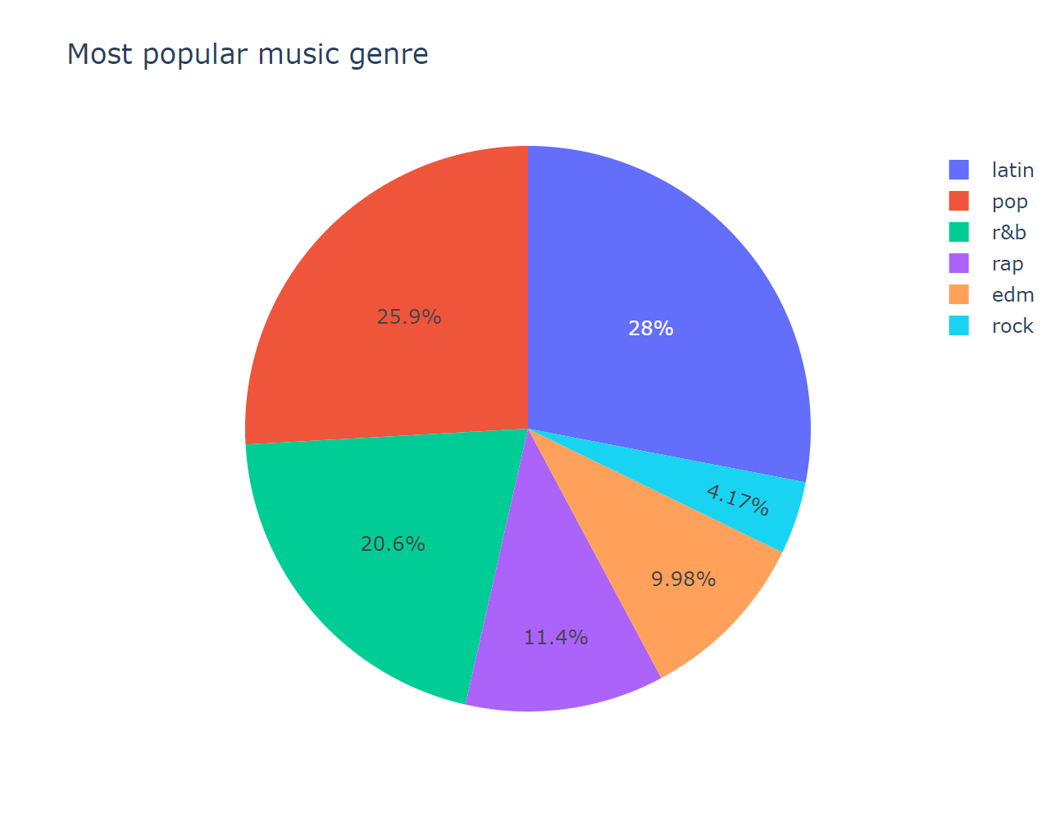
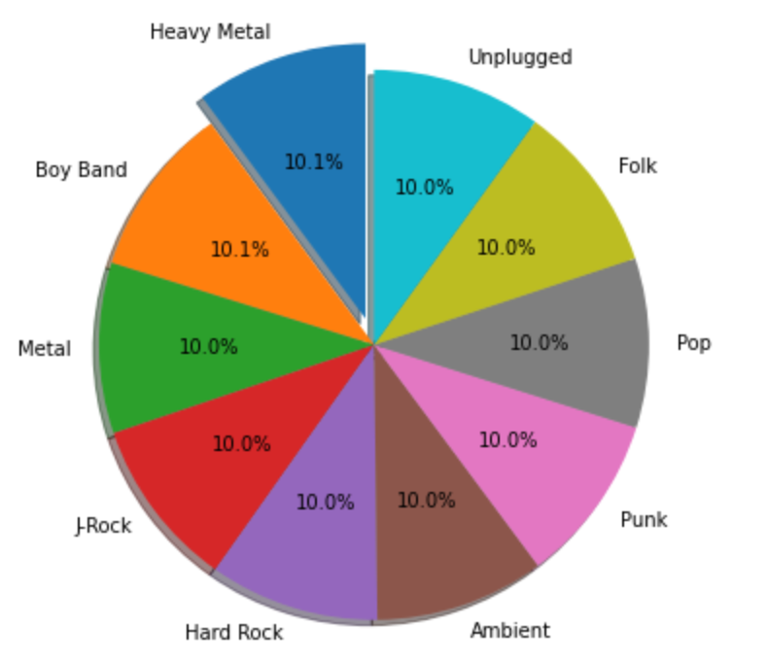
Popular Genre Distribution
The percentage for each genre with songs(tracks) having a popularity > 80
The percentage for top 10 album genre with highest average number of sales

Slide 25
06
Prediction
Notes:
Crystal

Slide 26
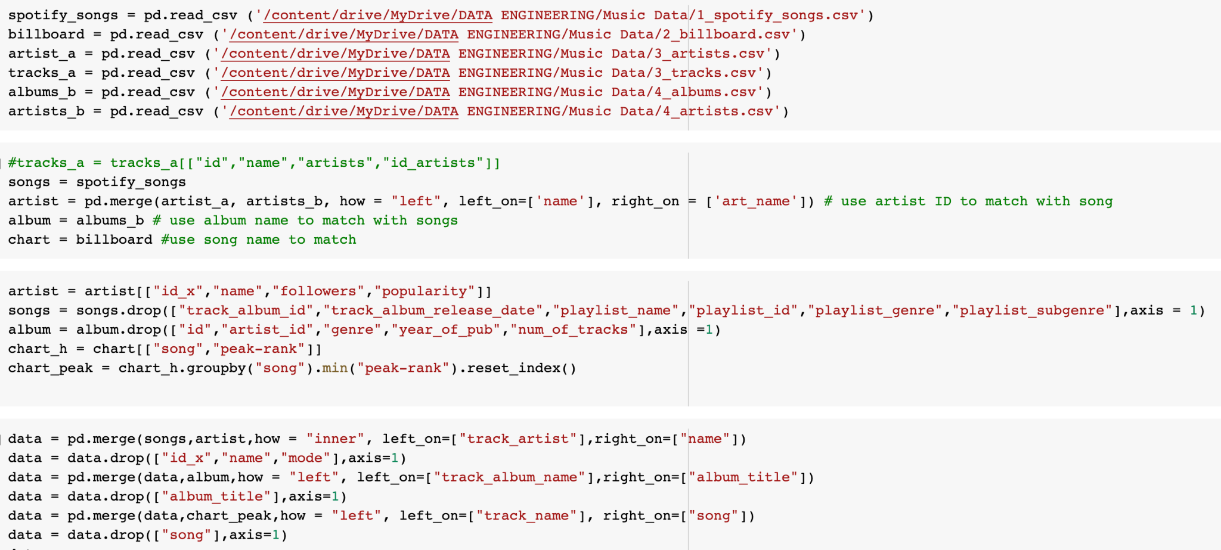
Data Preparation & Engineering
- Read, merge, select data
- Merge data by artist name, album name, and song name
Fill null by mean or “0”
Train test split
Notes:
Crystal

Slide 27
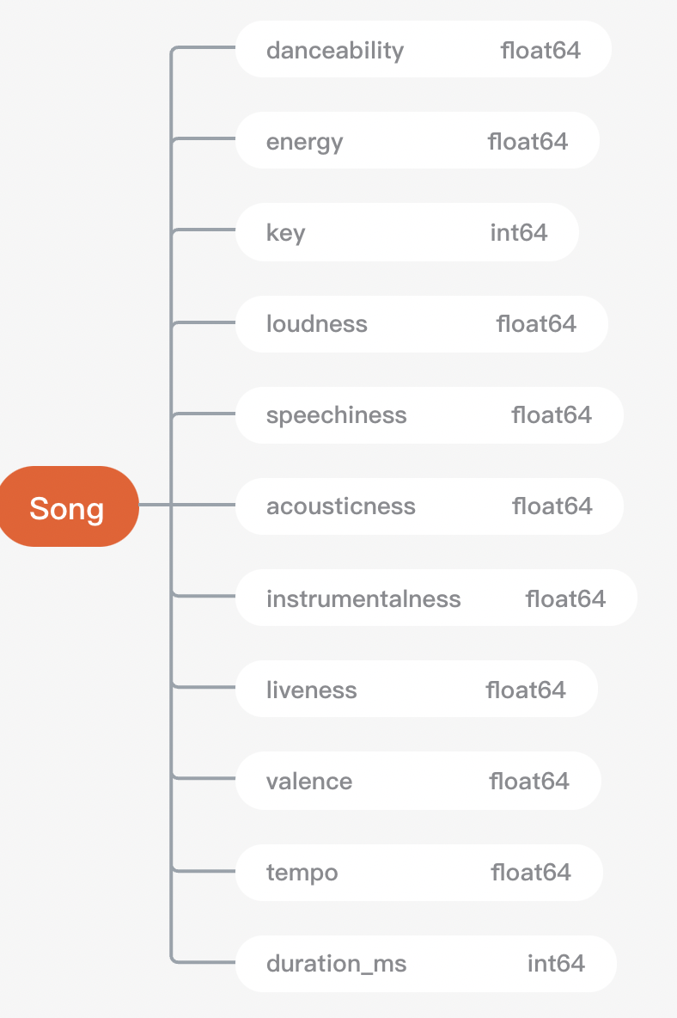
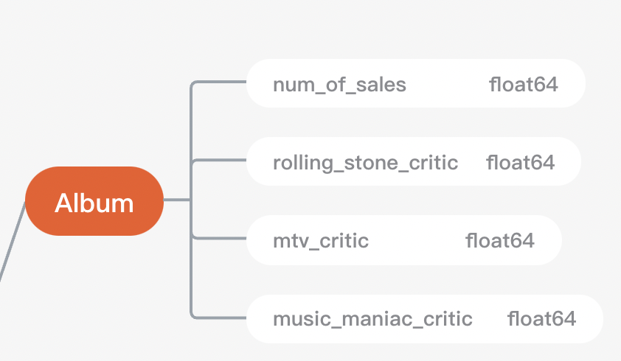
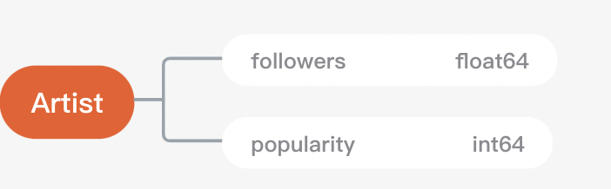
Features
Notes:
Crystal

Slide 28
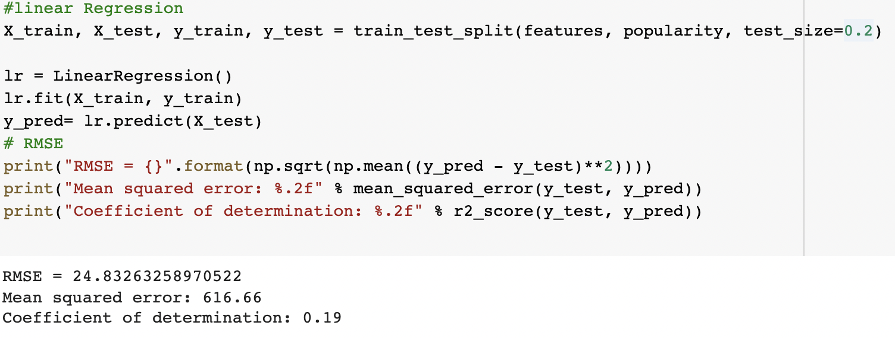
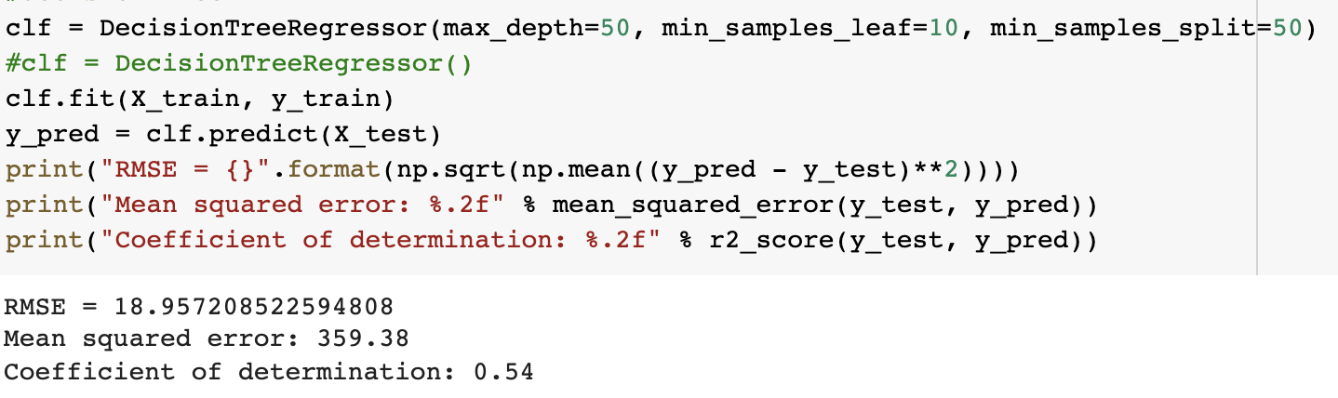
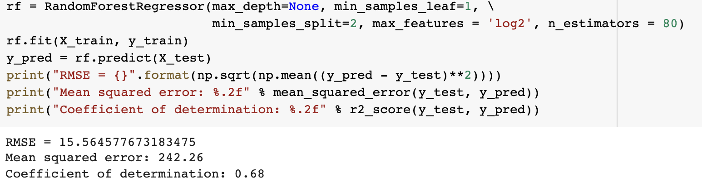
Popularity Prediction
Predict Popularity Score
Range (0,100)
Shows how popular the track is relatively to other tracks in the Spotify System.
Ex. <Dance Monkey> by “Tones and I” has popularity = 100
The model can be used to predict how popular a song may become
Linear Regression
Model Performance
RMSE = 15.56; R square = 0.68
The model still need to be improved.
Other features should be considered.
Decision Tree Regression
Random Forest Regression
Notes:
Crystal

Slide 29
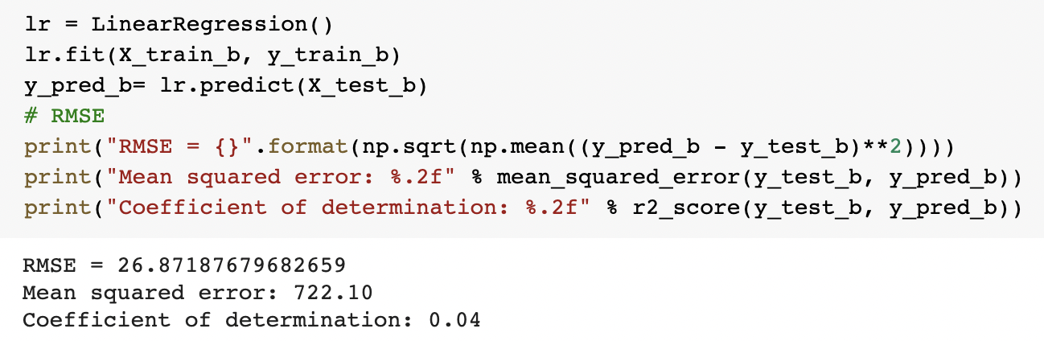
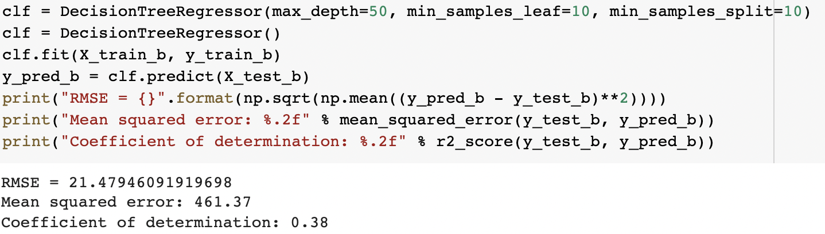
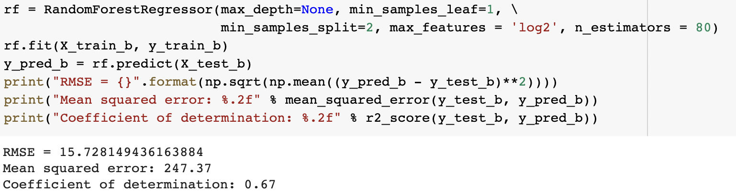
Billboard Peak Rank Prediction
Predict the peak rank on billboard
Rank Range (1,100)
Know the potential of the track
Problem & Possible Improvement:
Since the data set only include top 100 songs from billboard, and use song name to match the data, the data might be biased, which caused the bad performance of model
Try other features. Current feature set is not closely related to the Billboard Rank. Adding other features seems necessary
Linear Regression
Decision Tree Regression
Model Performance
RMSE = 15.73; R square = 0.67
The RMSE is relatively high and R square is not high. The model performance is not good enough.
Random Forest Regression
Notes:
Crystal

Slide 30
Conclusion
INSIGHTS:
Provide insights on the attributes of hit songs
Pop, Latin and R&B are popular genres
Higher danceability, energy and loudness
Models can be used to predict how popular a song will be, helping the recording company or the producers to select songs and make marketing decisions, especially on the A&R stage
FUTURE WORK:
Model improvements
Adding features
Feature selection and Engineering
Try other algorithms
Adding data sets from other mainstream charts and streaming platforms, like Apple music, Youtube, Amazon Music, Rolling Stone and Grammy
Adding data sets from social media and search engine

Slide 31



OUR TEAM
Crystal Xu
Diandian Yuan
Ruoxin Shi
MScA Full Time Student
MScA Full Time Student
MScA Full Time Student

Slide 32

THANKS
Do you have any questions?

